Slide 1
Senior Year CCMR Required Activities

Slide 2
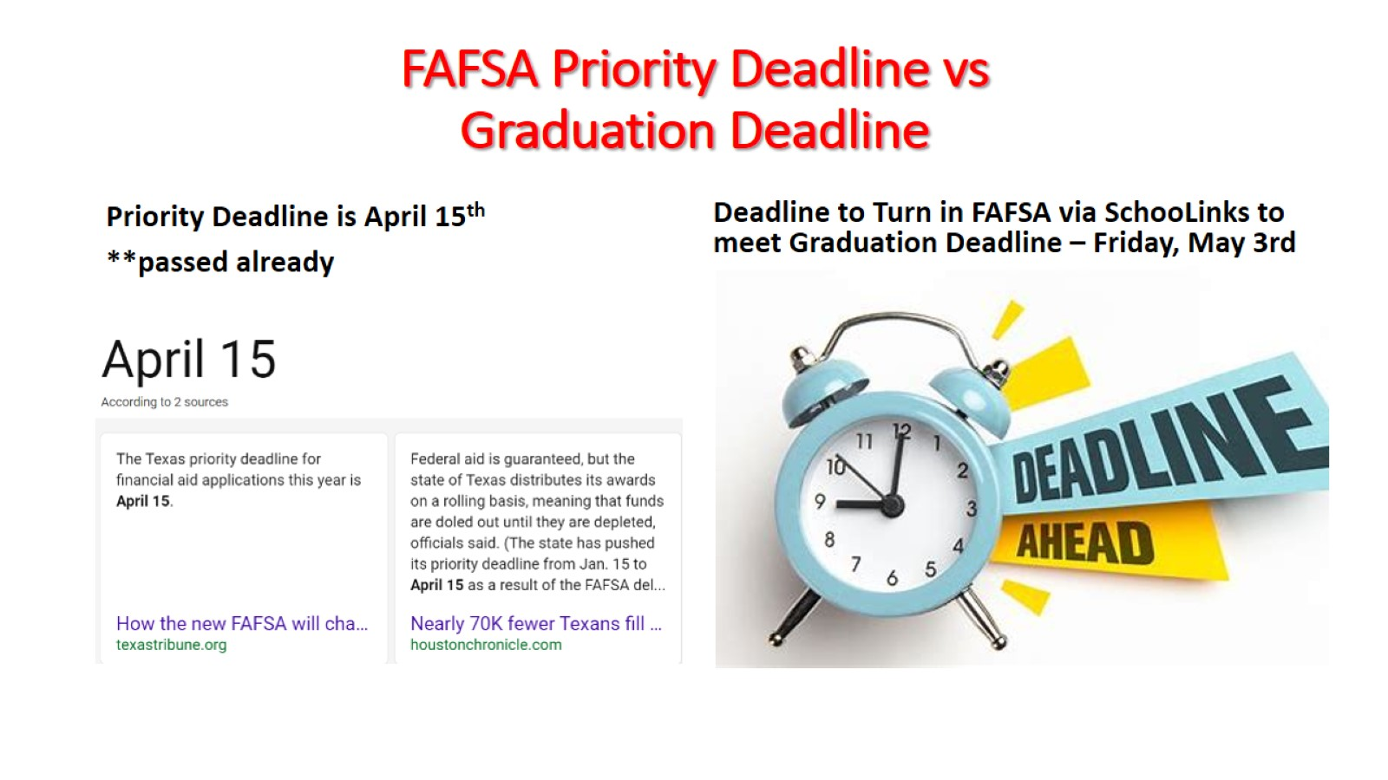
FAFSA Priority Deadline vs Graduation Deadline

Slide 3
Workarounds & Proof of Completion Submission Options

Slide 5
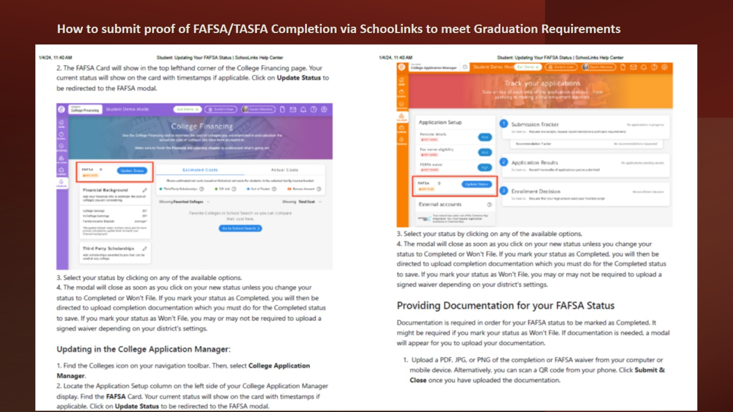

Slide 6
Upload proof to of FAFSA Completion

Slide 7
Time to show out for your Parents & Loved Ones!!

Slide 8
Senior Year-End Activity: Graduation Survey How to Videos & Instructions

Slide 9
Senior Year-End Survey – Graduation Survey

Slide 10
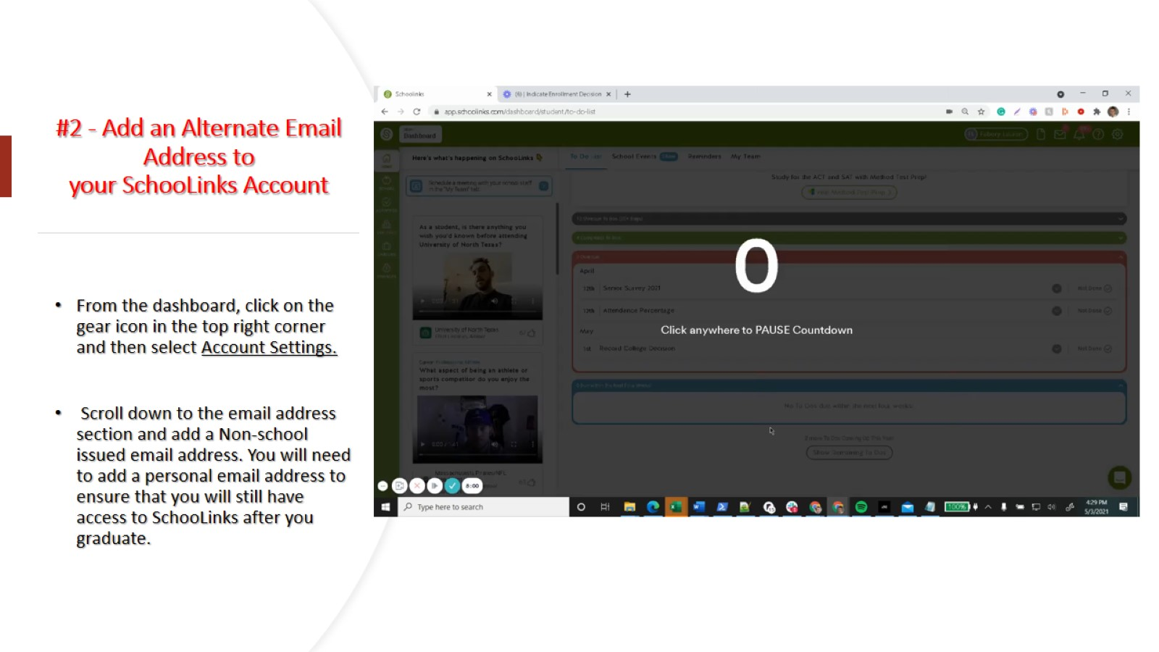
#2 - Add an Alternate Email Address to your SchooLinks Account

Slide 12
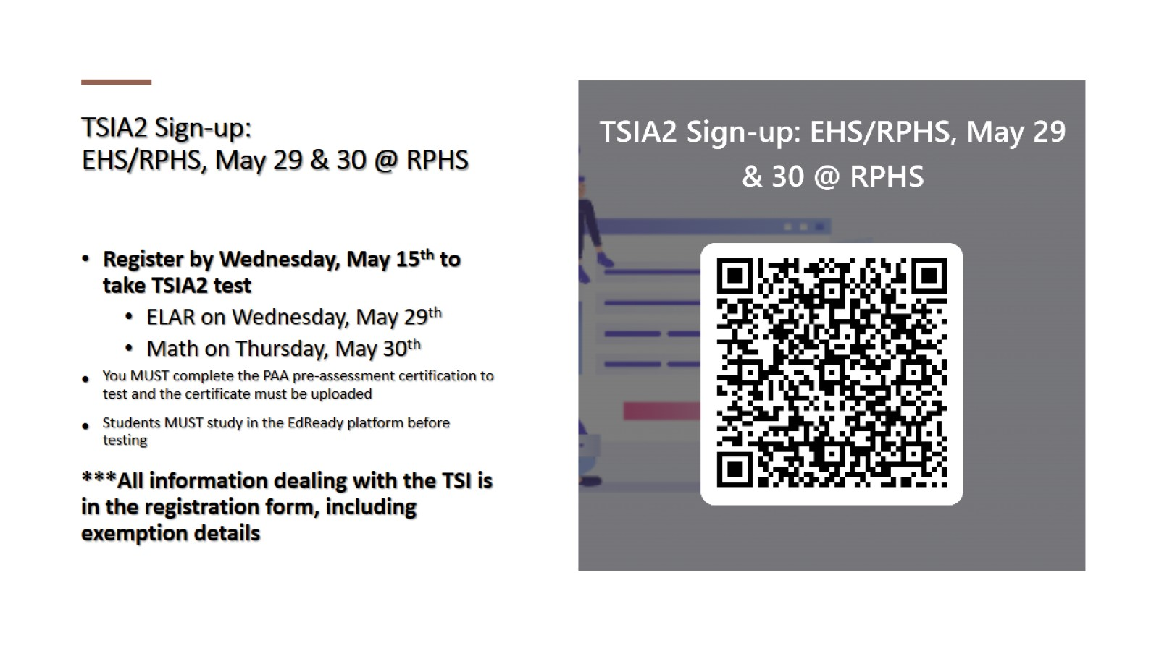
TSIA2 Sign-up: EHS/RPHS, May 29 & 30 @ RPHS

Slide 13
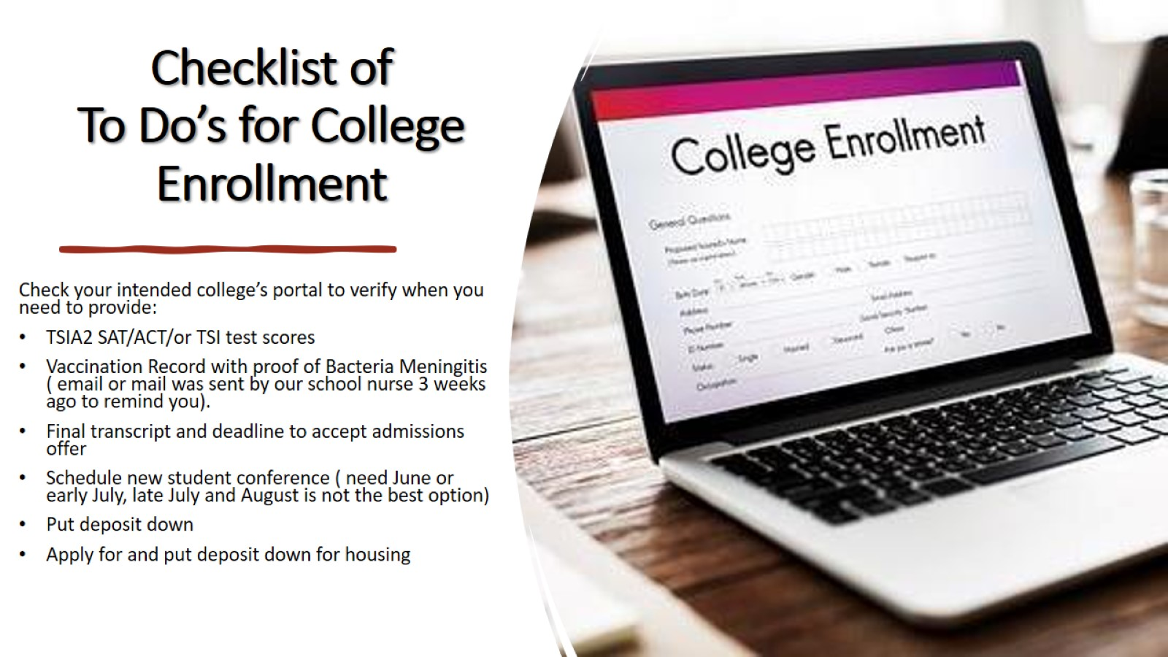
Checklist of To Do’s for College Enrollment

Slide 14
Bacteria Meningitis Video https://youtu.be/h2-U1S74OH0

Slide 15
Senior Year CCMR Required Activities

